Slide 1
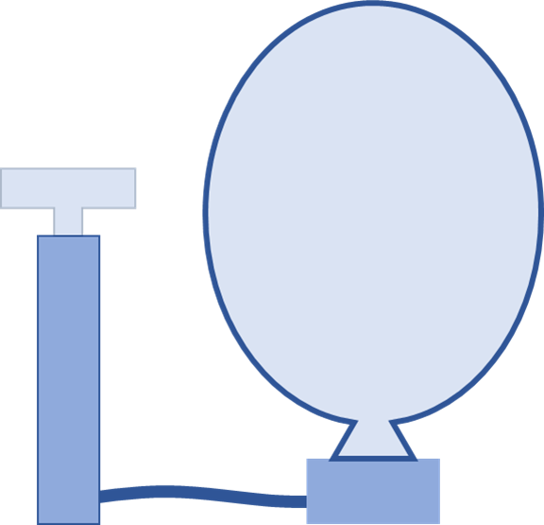

Slide 2
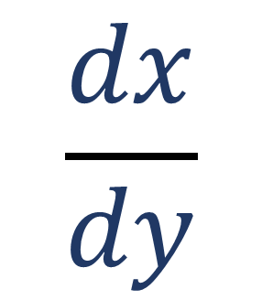
$$\frac{dx}{dy}$$
differentials

Slide 4
Ladder
Wall
10ft
?
1ft/s
Floor
6ft

Slide 5
C = ladder
A = wall
B = floor

Slide 6
4ft/s
15ft
20ft

Slide 7


O=15ft
A=20ft
$$\tan{θ}=\frac{O}{A}$$
$$θ$$

